Slide 1
Exploratory Data Analysis: Flight Prices
Done by Ga fellows:
Yusuf AlDamami
Khadija Khamis
Ahmed AlSaeed

Slide 2
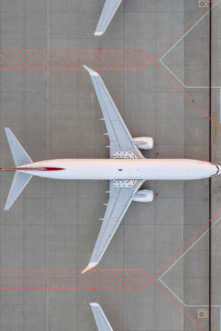
Project Overview
Objective: Uncovering pricing patterns and actionable insights from Expedia flight data in May 2022.
Focus: Top airports, day of the week effects and Cheapest daily fare.
The dataset is in CSV format.
Each row represents a purchasable ticket found on Expedia.
Data was collected between 2022-04-16 and 2022-10-05.
Tickets are for flights to/from major U.S. airports, including: ATL, DFW, DEN, ORD, LAX, CLT, MIA, JFK, EWR, SFO, DTW, BOS, PHL,LGA,IAD,OAK.

Slide 3
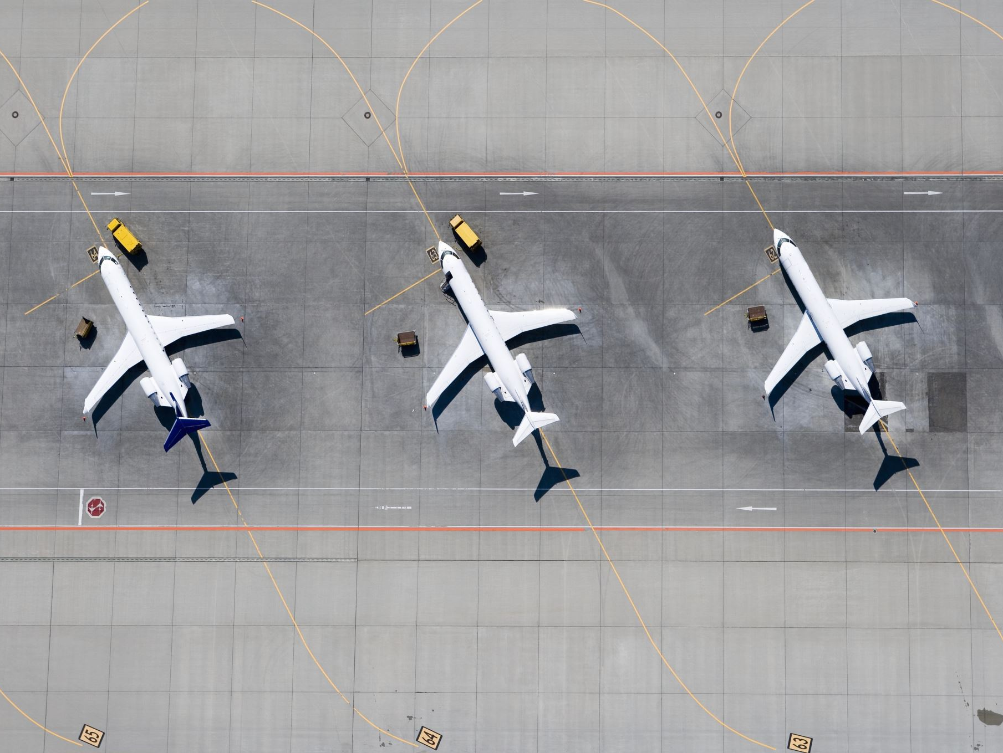
Info of the data available
5 million flight records collected from Expedia from Kaggle
Focused EDA on May 2022 2.87M flights
Coverage: All U.S. domestic flights
Mean Base Fare: $303.20
Mean Total Fare: $351.63
Median Base Fare: $273.49

Slide 4
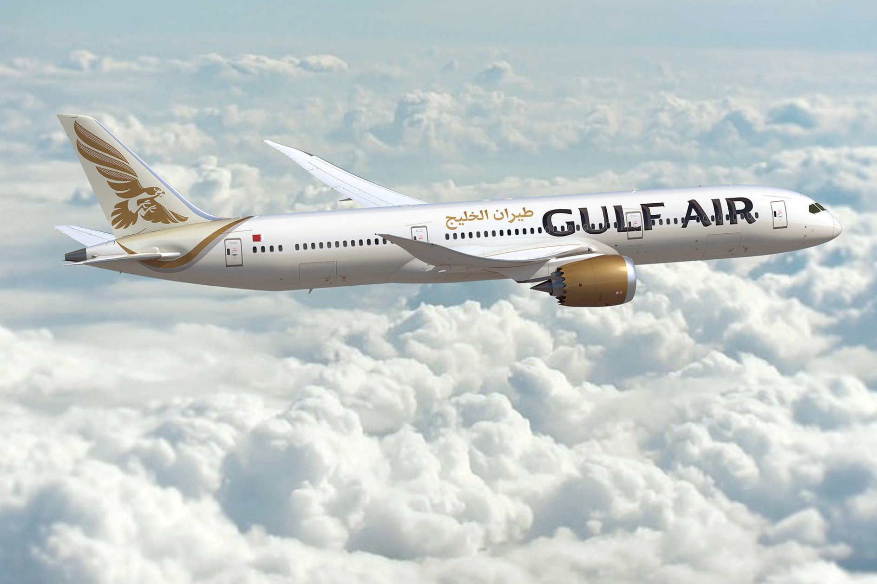
Next up Exploratory Data Analysis
With a large focus on the month of May

Slide 5
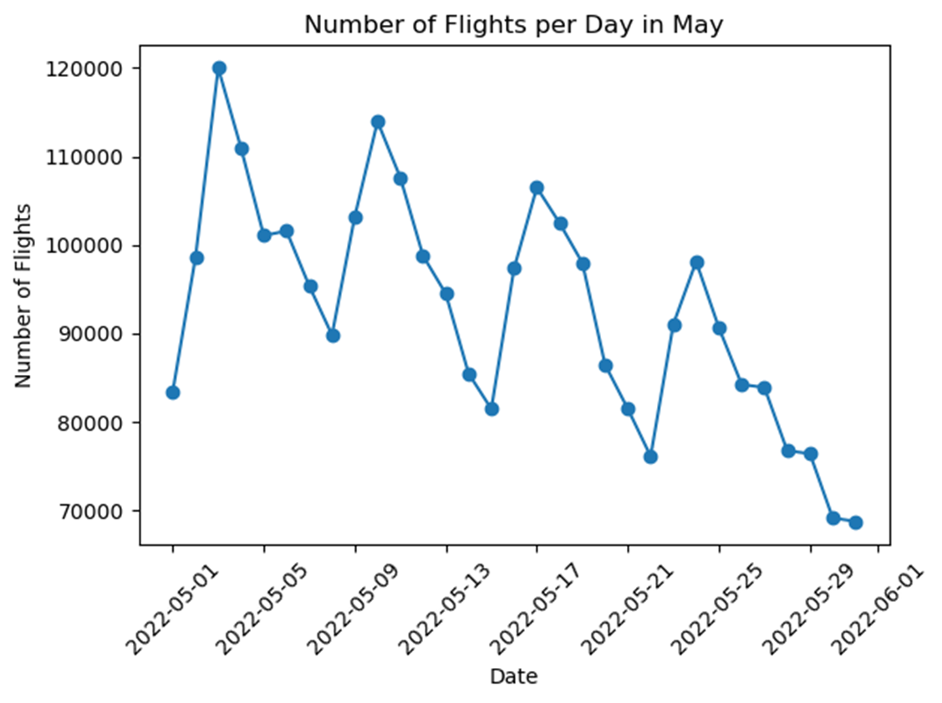
Number of Flight per Day in May
Date | Flight
01/05/2022 | 83409
02/05/2022 | 98589
03/05/2022 | 120002
04/05/2022 | 110983
05/05/2022 | 101073
06/05/2022 | 101594
07/05/2022 | 95382
08/05/2022 | 89835
09/05/2022 | 103230
10/05/2022 | 113966
11/05/2022 | 107631
12/05/2022 | 98788
13/05/2022 | 94495
14/05/2022 | 85487
15/05/2022 | 81482
16/05/2022 | 97367
17/05/2022 | 106506
18/05/2022 | 102479
19/05/2022 | 97985
20/05/2022 | 86474
21/05/2022 | 81481
22/05/2022 | 76136
23/05/2022 | 91068
24/05/2022 | 98140
25/05/2022 | 90655
26/05/2022 | 84246
27/05/2022 | 83906
28/05/2022 | 76769
29/05/2022 | 76426
30/05/2022 | 69159
31/05/2022 | 68776
Notes:
Original chart from notebook: top airports by departures.

Slide 6
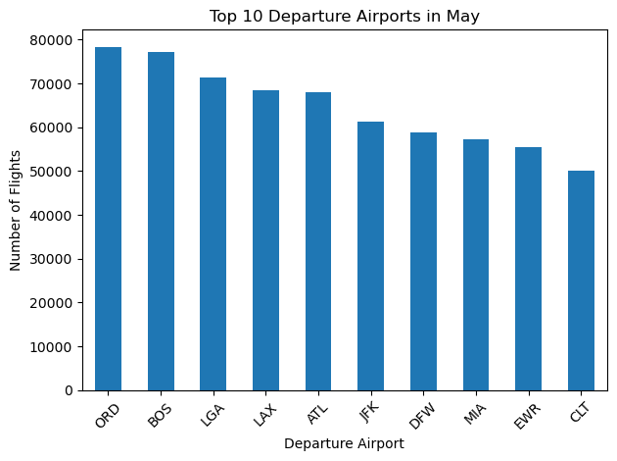
Top 10 Departure Airports in May
Airport | ORD | BOS | LGA | LAX | ATL | JFK | DFW | MIA | EWR | CLT
Flight | 78339 | 77290 | 71379 | 68346 | 67972 | 61351 | 58923 | 57320 | 55420 | 50036

Slide 7
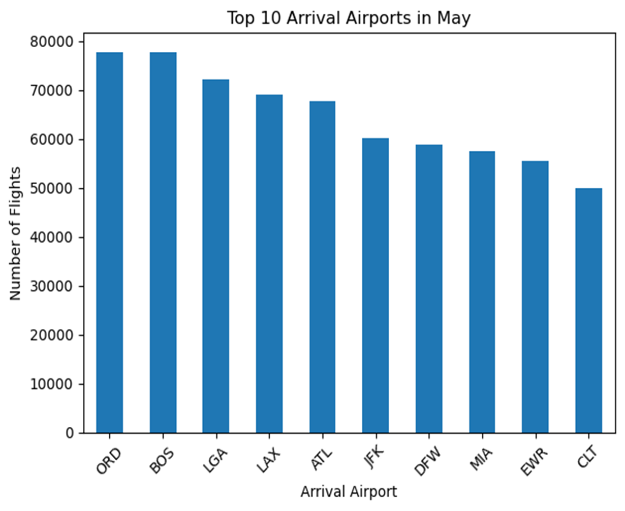
Top 10 Arrival Airports in May
Airport | ORD | BOS | LGA | LAX | ATL | JFK | DFW | MIA | EWR | CLT
Flight | 77727 | 77724 | 72036 | 69111 | 67655 | 60130 | 58719 | 57379 | 55408 | 50039

Slide 8
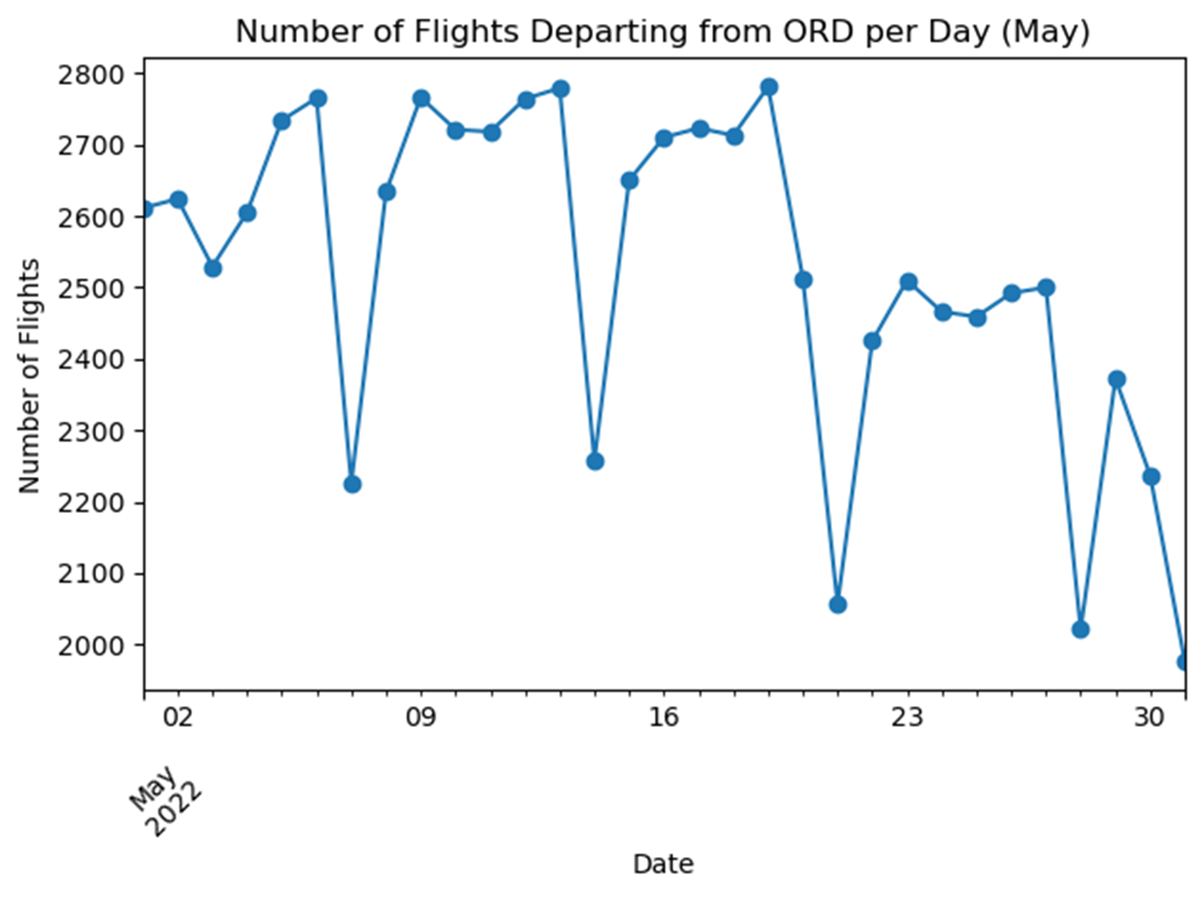
Number of Flights Departing from ORD per Day (May)
Date | Filght
01/05/2022 | 2611
02/05/2022 | 2624
03/05/2022 | 2529
04/05/2022 | 2605
05/05/2022 | 2734
06/05/2022 | 2765
07/05/2022 | 2226
08/05/2022 | 2634
09/05/2022 | 2766
10/05/2022 | 2721
11/05/2022 | 2718
12/05/2022 | 2764
13/05/2022 | 2779
14/05/2022 | 2258
15/05/2022 | 2650
16/05/2022 | 2710
17/05/2022 | 2723
18/05/2022 | 2713
19/05/2022 | 2781
20/05/2022 | 2513
21/05/2022 | 2057
22/05/2022 | 2425
23/05/2022 | 2510
24/05/2022 | 2466
25/05/2022 | 2459
26/05/2022 | 2492
27/05/2022 | 2500
28/05/2022 | 2021
29/05/2022 | 2372
30/05/2022 | 2237
31/05/2022 | 1976

Slide 9
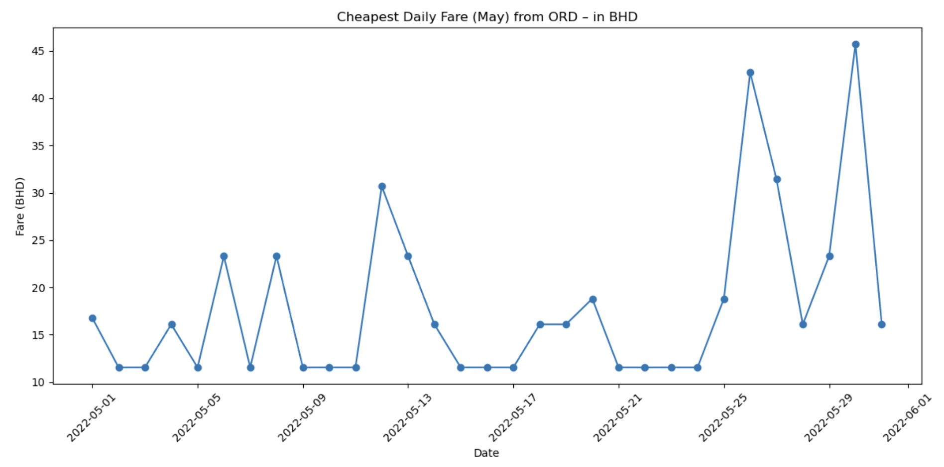
Cheapest Daily Fare (May) from ORD – in BHD
Date | Filght
01/05/2022 | 16.77
02/05/2022 | 11.54
03/05/2022 | 11.54
04/05/2022 | 16.09
05/05/2022 | 11.54
06/05/2022 | 23.3
07/05/2022 | 11.54
08/05/2022 | 23.3
09/05/2022 | 11.54
10/05/2022 | 11.54
11/05/2022 | 11.54
12/05/2022 | 30.68
13/05/2022 | 23.3
14/05/2022 | 16.09
15/05/2022 | 11.54
16/05/2022 | 11.54
17/05/2022 | 11.54
18/05/2022 | 16.09
19/05/2022 | 16.09
20/05/2022 | 18.8
21/05/2022 | 11.54
22/05/2022 | 11.54
23/05/2022 | 11.54
24/05/2022 | 11.54
25/05/2022 | 18.8
26/05/2022 | 42.71
27/05/2022 | 31.43
28/05/2022 | 16.09
29/05/2022 | 23.3
30/05/2022 | 45.72
31/05/2022 | 16.09

Slide 10
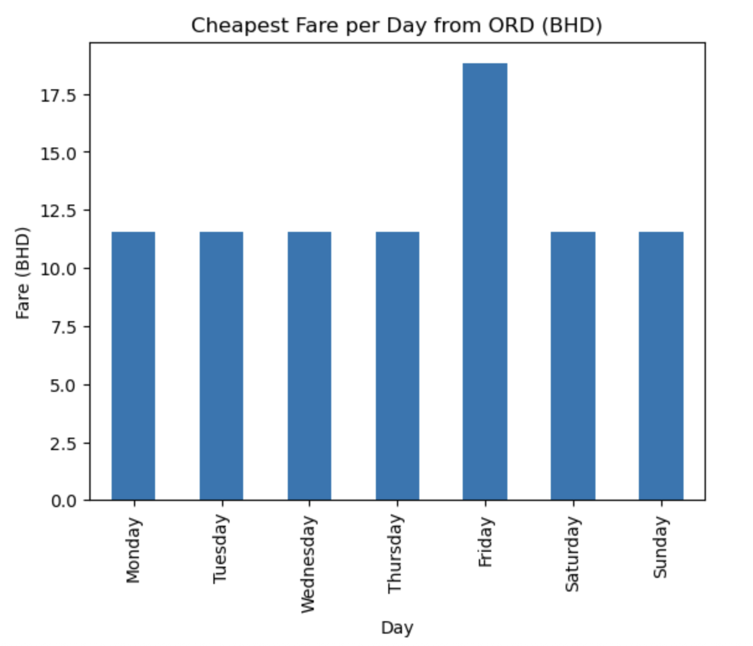
Cheapest Fare per Day from ORD (BHD)
Day | Airline Name | Total Fare | Fare BHD
Monday | Spirit Airlines | 30.69 | 11.53944
Tuesday | Spirit Airlines | 30.69 | 11.53944
Wednesday | Spirit Airlines | 30.69 | 11.53944
Thursday | Spirit Airlines | 30.69 | 11.53944
Friday | Spirit Airlines | 50 | 18.8
Saturday | Spirit Airlines | 30.69 | 11.53944
Sunday | Spirit Airlines | 30.69 | 11.53944

Slide 11
Conclusion:
The flight data analysis revealed that the cheapest tickets in May from ORD (Chicago O’Hare) to MIA (Miami).
Spirit Airlines consistently offered the lowest fares.
Mondays and Tuesdays had the lowest prices, averaging around 11.5 BHD per ticket.
This is likely due to lower travel demand at the beginning of the week, prompting airlines to reduce fares to fill seats.
Recommendations:
Avoid weekends.
Focus on non-stop economy flights.

Slide 12

Thank you for listening 😊 Any questions?

